Slide 1
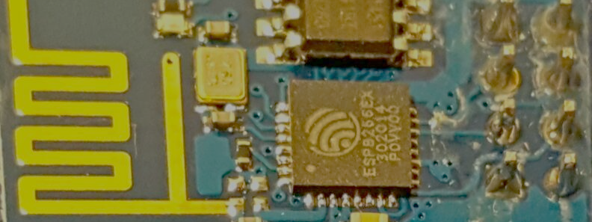
Getting started with ESP8266 and IOT
From a beginner Hobbyist to a beginner Hobbyist.
Ahmed Maklad

Slide 2
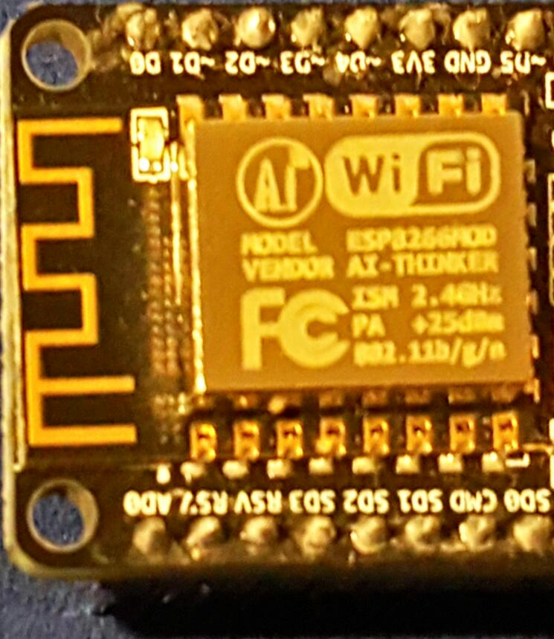
License
http://blog.maksoft.ch/tutorials/
Creative Commons with attribute to http://blog.Maksoft.ch/
Creative Commons Attribution-NonCommercial-ShareAlike 3.0 Unported License.

Slide 3
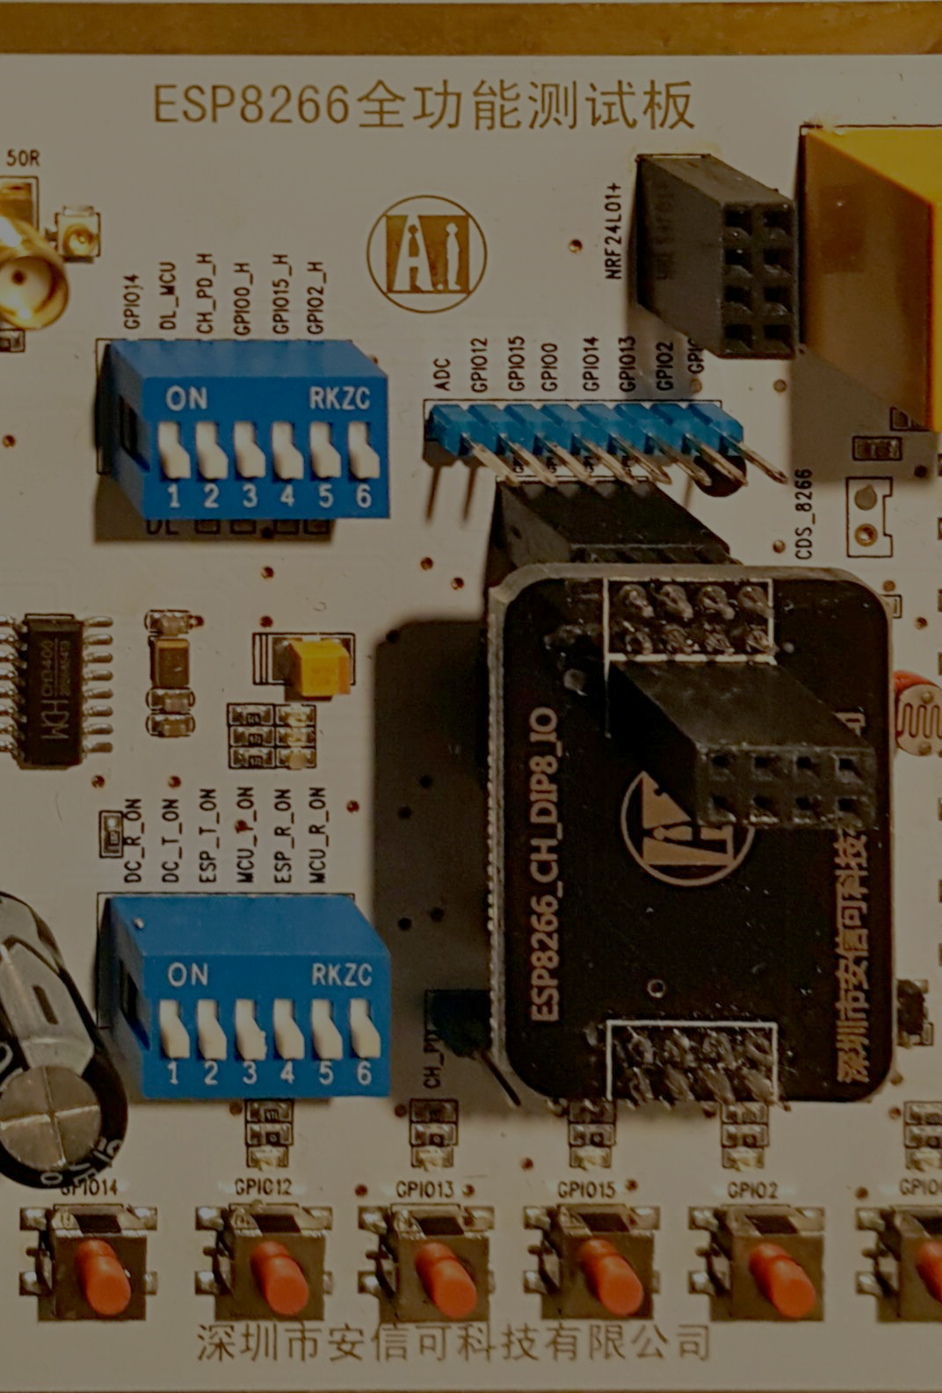
Objectives
From a beginner hobbyist to a beginner hobbyist.
Quick start guide for programming ESP8266 and using it your Hobby projects.
Share the ESP8266 experience.
Focused on programming ESP8266 by Arduino IDE with Examples but also tell about other usage scenarios.
What you need to start ? where to start ?
Introduce terminology of Cloud and IOT.
ESP8266 alternatives for Hobbyists.

Slide 4

Agenda
How hobbyists use the ESP8266 ?
  As an Arduino WIFI Modem (original factory Firmware)
  As a programmable interpreter (Lua, Basic, Python ..etc)
  As and Arduino IDE programmable MCU.
Hardware
  What is it ?
  Form Factors and NodeMCU
Software
  Cloud Products (thingsspeak , OpenHAB, …etc)
  Arduino IDE Examples:
    Wifi Station
    Wifi AP
    Web Client for NTP service.
    WifiConfig library
Other Options (competition)
Other Web Resources.

Slide 5
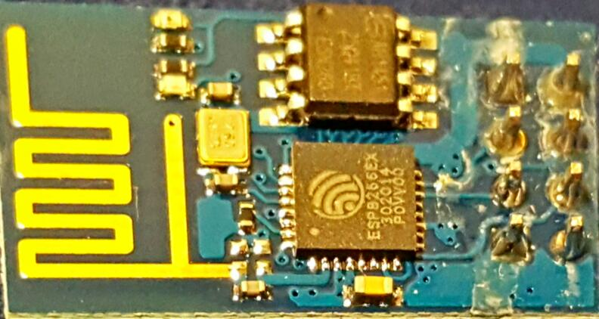
What is an ESP8266 ?
A low cost WIFI chip with full TCP/IP stack and MCU.
Produced by Shanghai-based Chinese manufacturer Espressif Systems.
http://hackaday.com
AI Thinker Modules
NodeMCU developer board.
WiMos
…

Slide 6
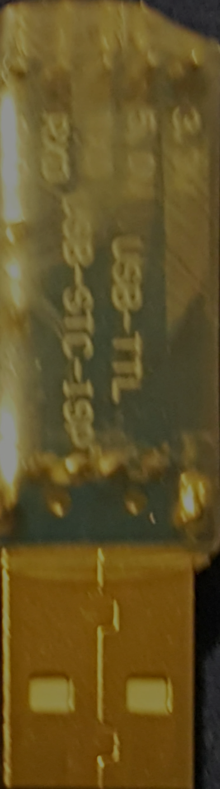
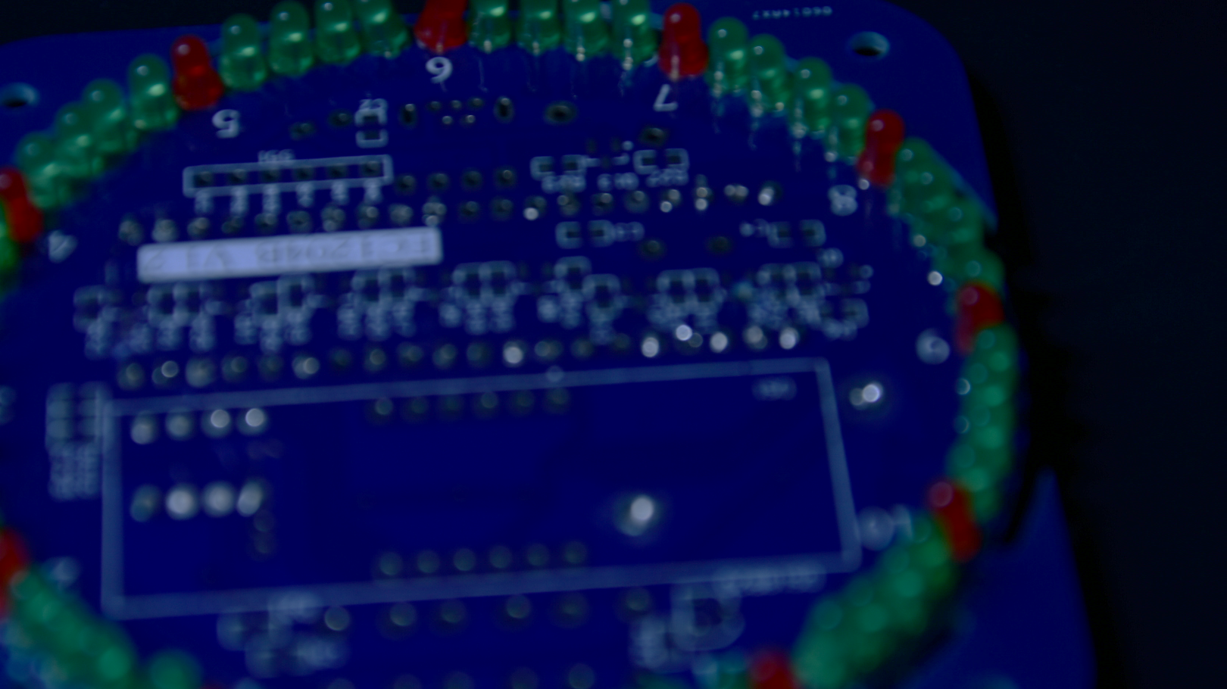
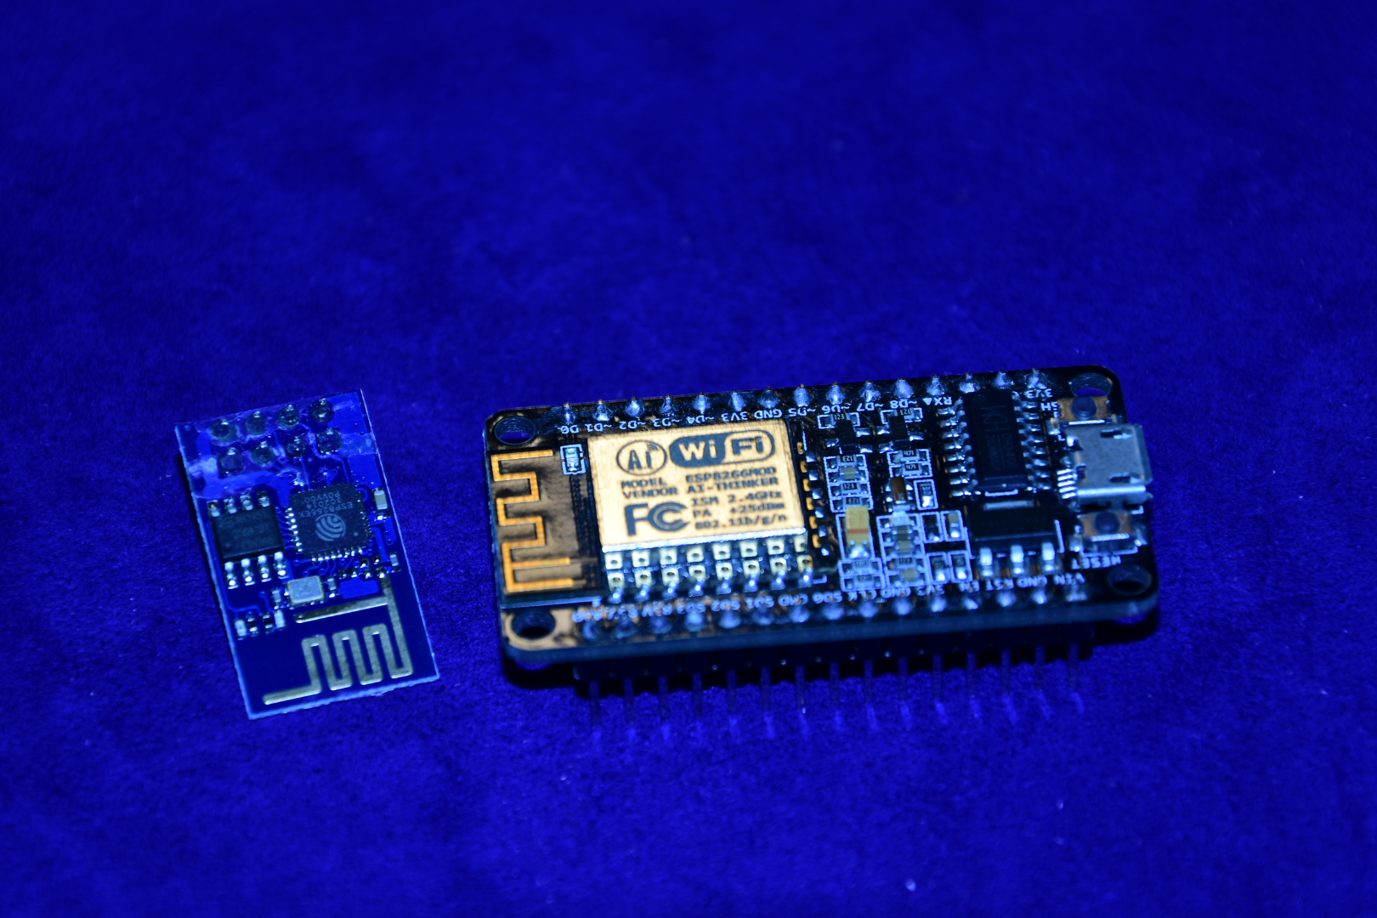
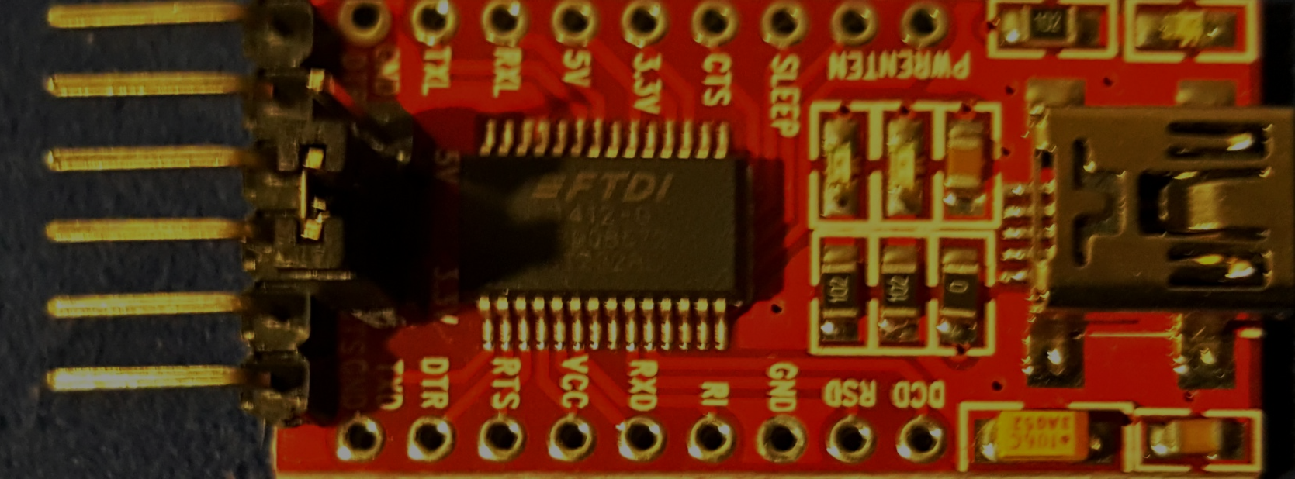
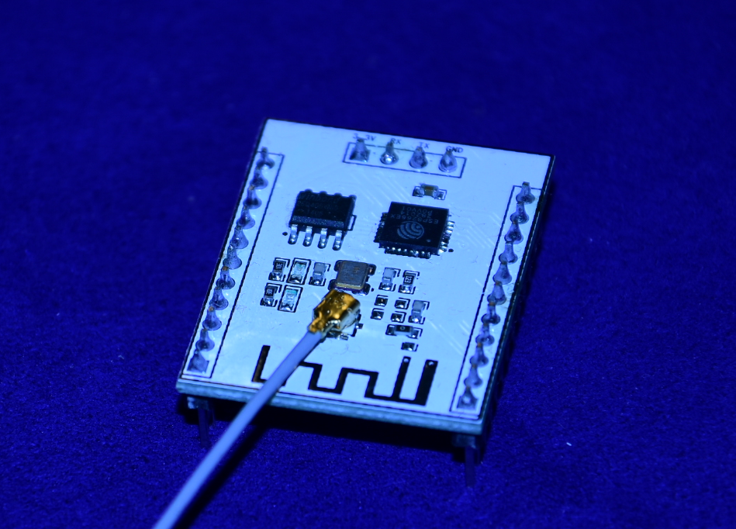
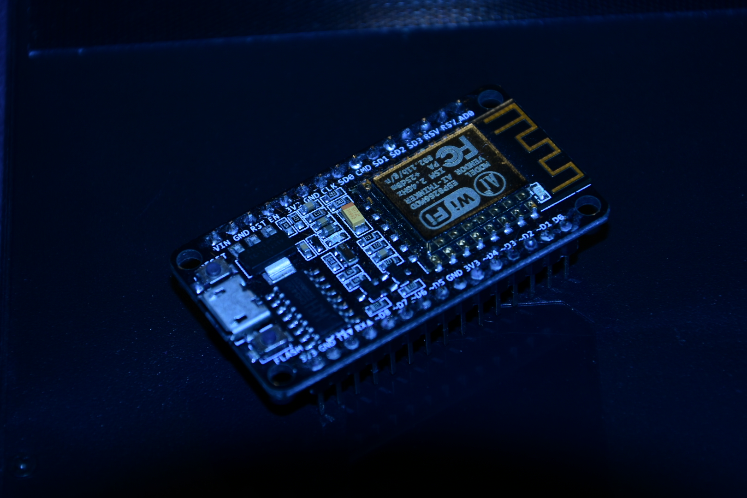
Form Factors
ESP8266-01
ESP8266-XX
ESP8266-12
ESP8266-12E
NodeMCU
Sonoff (commercial product)
  A/C ~10Amps Relay
  Programmable pins (almost) exposed

Slide 7

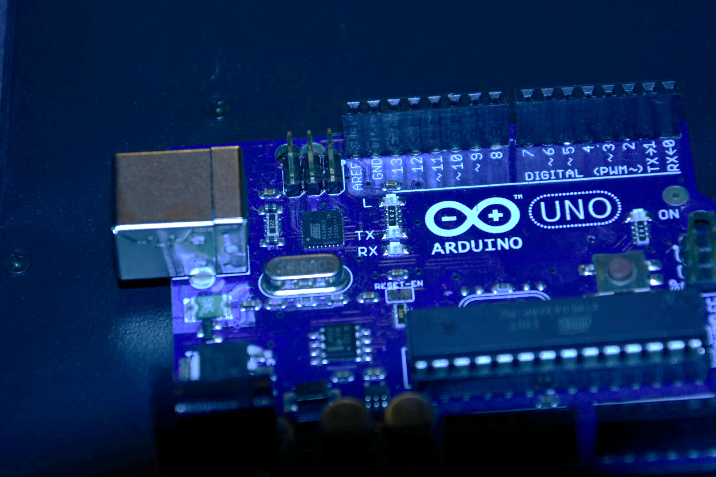
How to use the ESP8266 ? (use cases)
Arduino WIFI Modem
Factory Firmware
(AT Commands.)
Lua Programming
Basic Programming
JavaScrip Programming
MicroPython Programming
Arduino IDE
#include <ESP8266WiFi.h>
EasyESP Firmware
(no programming)
Arduino Libraries & Eco System

Slide 8
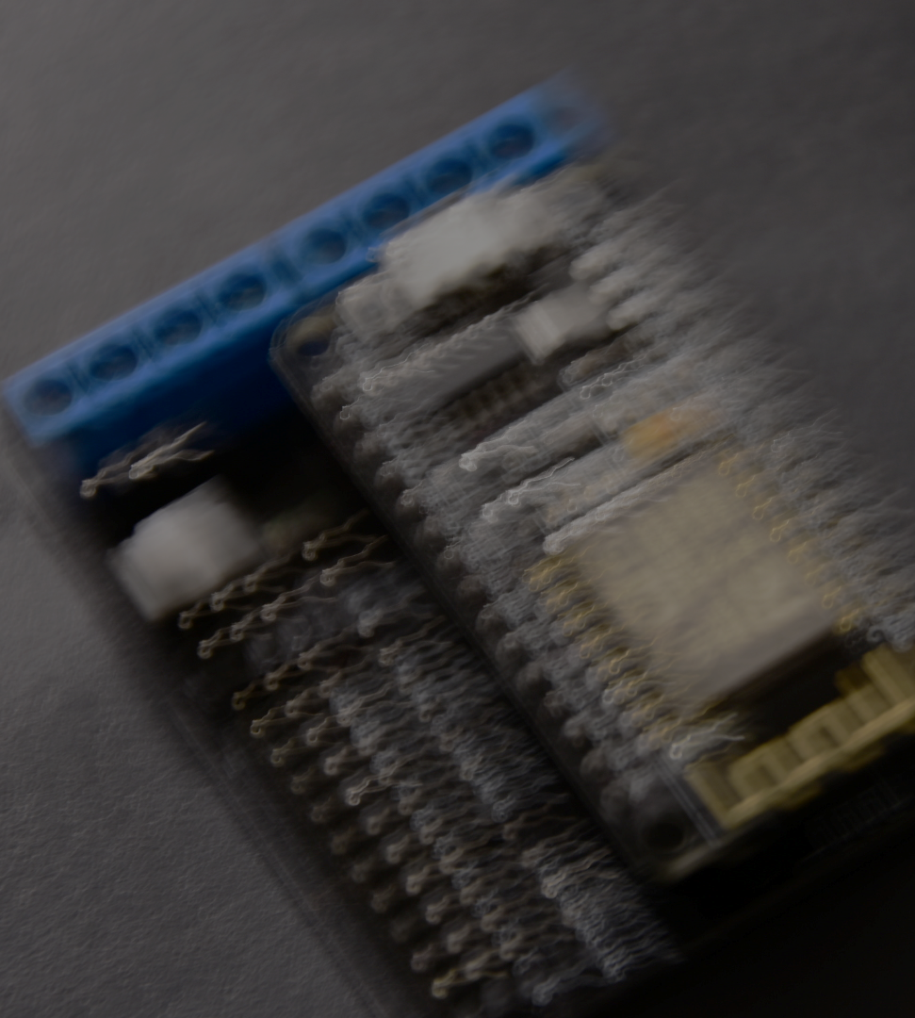
Flashing the ESP8266 (The Firmware)
The Firmware flashing tools:
  ESP8266Flasher.exe, you could upload multiple Firmwares: https://github.com/nodemcu/nodemcu-flasher
  Espressif Flash download tool: http://bbs.espressif.com/viewtopic.php?f=57&t=433
  Esptool.py
https://github.com/espressif/esptool
The available Firmwares:
  Flash the Lua Firmware https://github.com/nodemcu/nodemcu-firmware
  Basic programming Firmare https://www.esp8266basic.com/
  The microPython firmware https://docs.micropython.org/en/latest/esp8266/esp8266/tutorial/intro.html
  The original Espressif Firmware : http://bbs.espressif.com/download/file.php?id=991

Slide 9
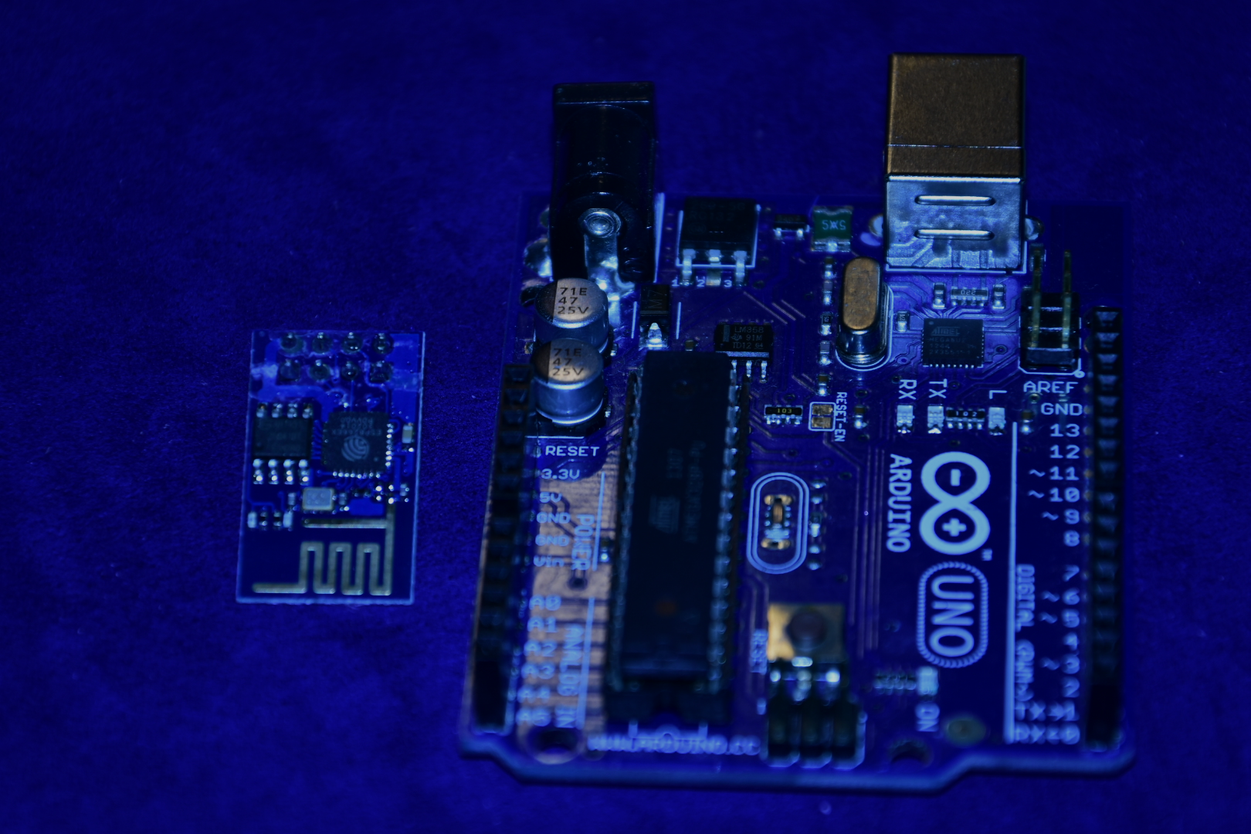
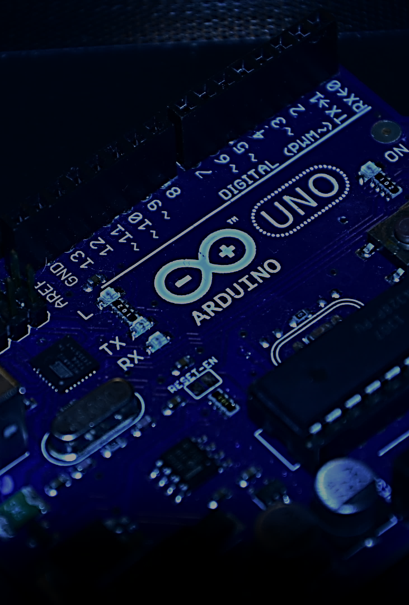
Uses of the ESP8266 (1)
As a WIFI modem for Arduino
  Connect the ESP8266 RX and TX to the Arduino TX and RX Serial pins respectively , GND and VCC to 3.3v
  Send AT Commands and respond to them via the serial port.
  Original Firmware on the ESP8266-01
  Other "AT" enabled Firmware available to add more features like NTP (time Query)
  Some projects use the Esp8266 as replacement for RTC (by NTP).
  A perfect Cheap WIFI shield for Arduino.
  ESP8266 Adafruite Library.
  Example AT command:
    AT+CWMODE=2 sets the ESP8266 in Access Point Mode
    AT+CWMODE queries the device which mode is it in now STA=1,AP=2,both=3

Slide 10
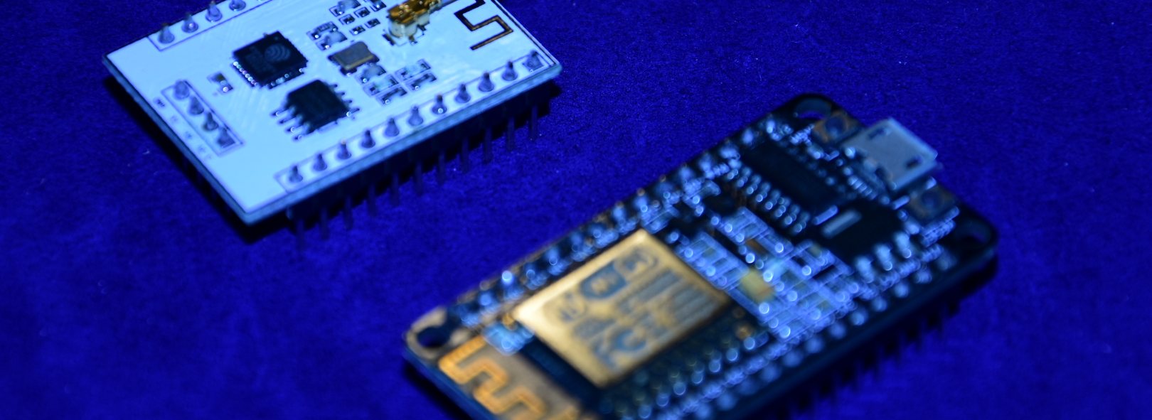
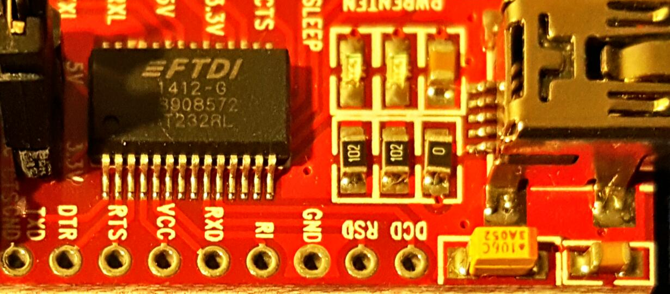
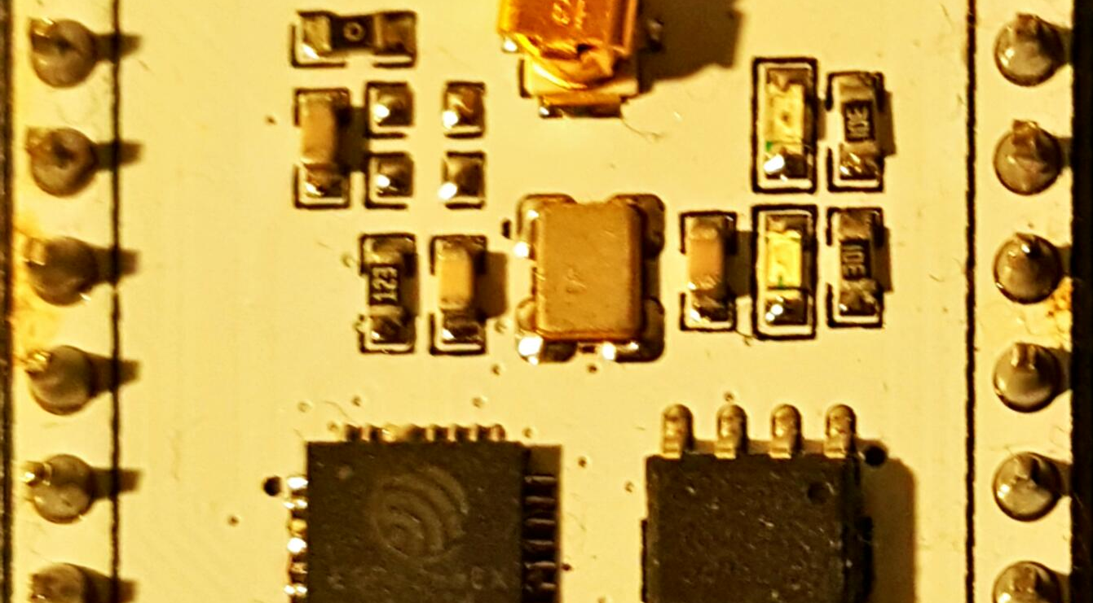
Uses of the ESP8266 (2)
Using the Basic , Lua or MicroPython firmware
"Esplorer" and "Lua Uploader" tools to upload the LUA code
Each implementation has its own eco-system of libraries.
You Burn the Firmware which is some kind of an Embedded interpreter and the text source code is uploaded using the tools mentioned above.

Slide 11
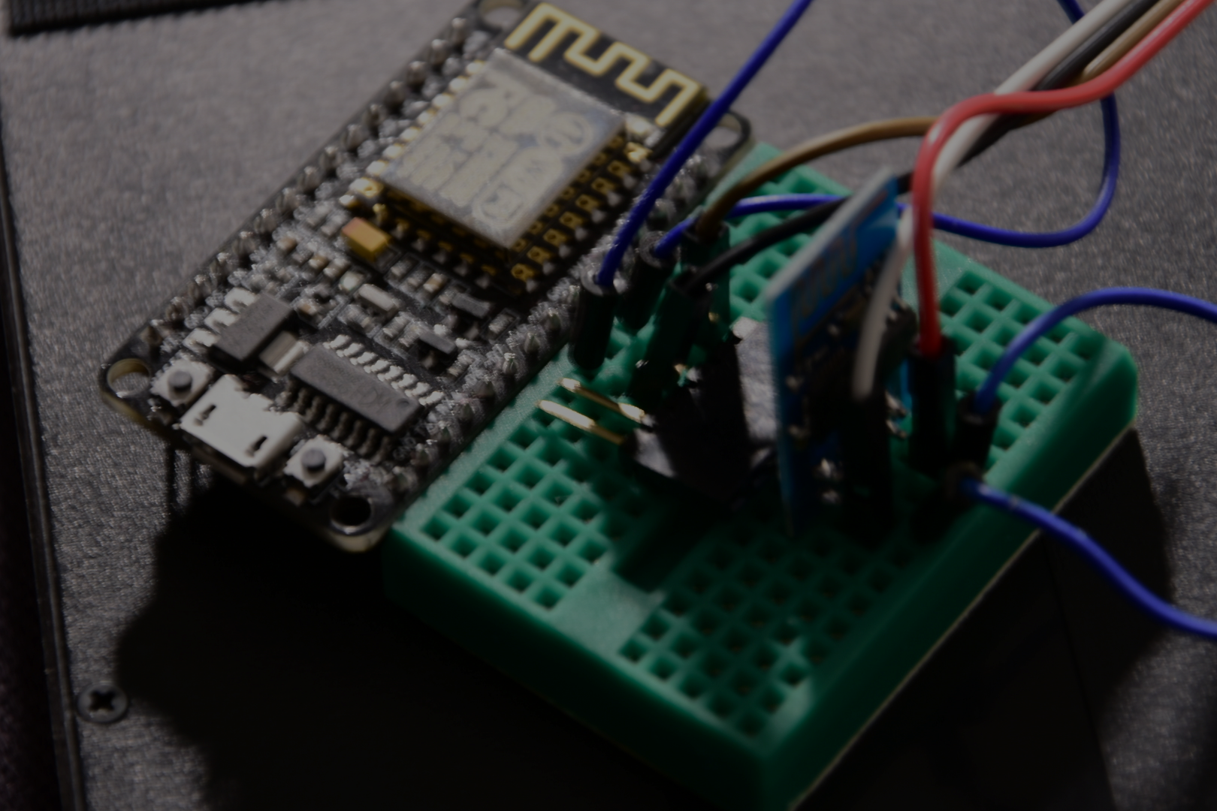
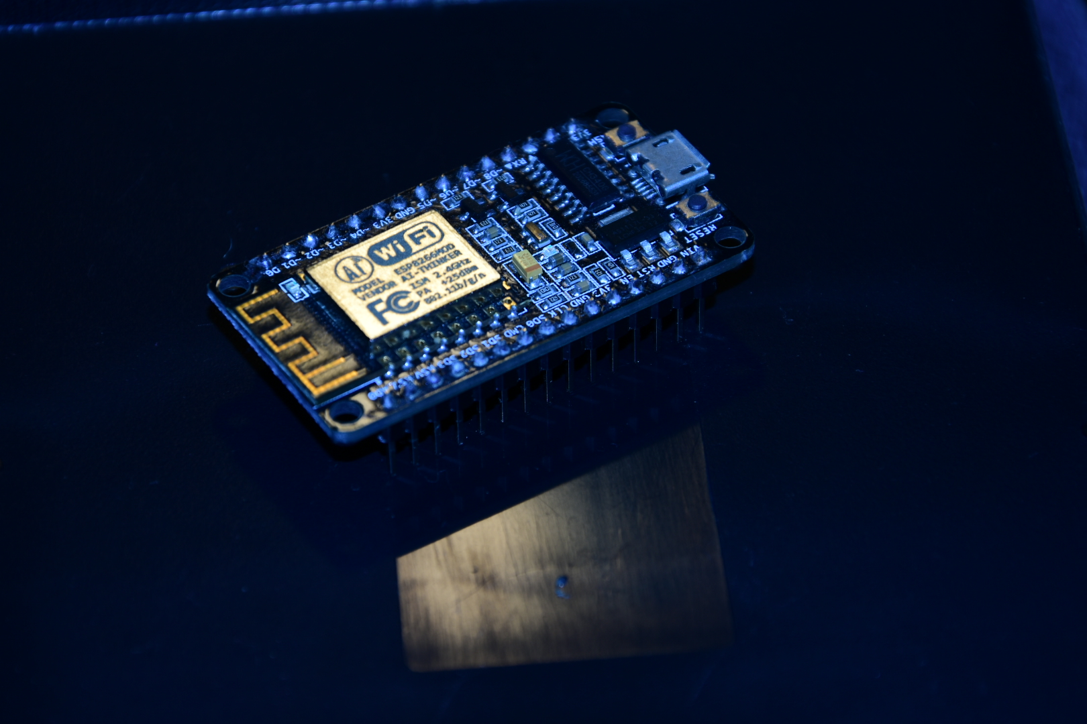
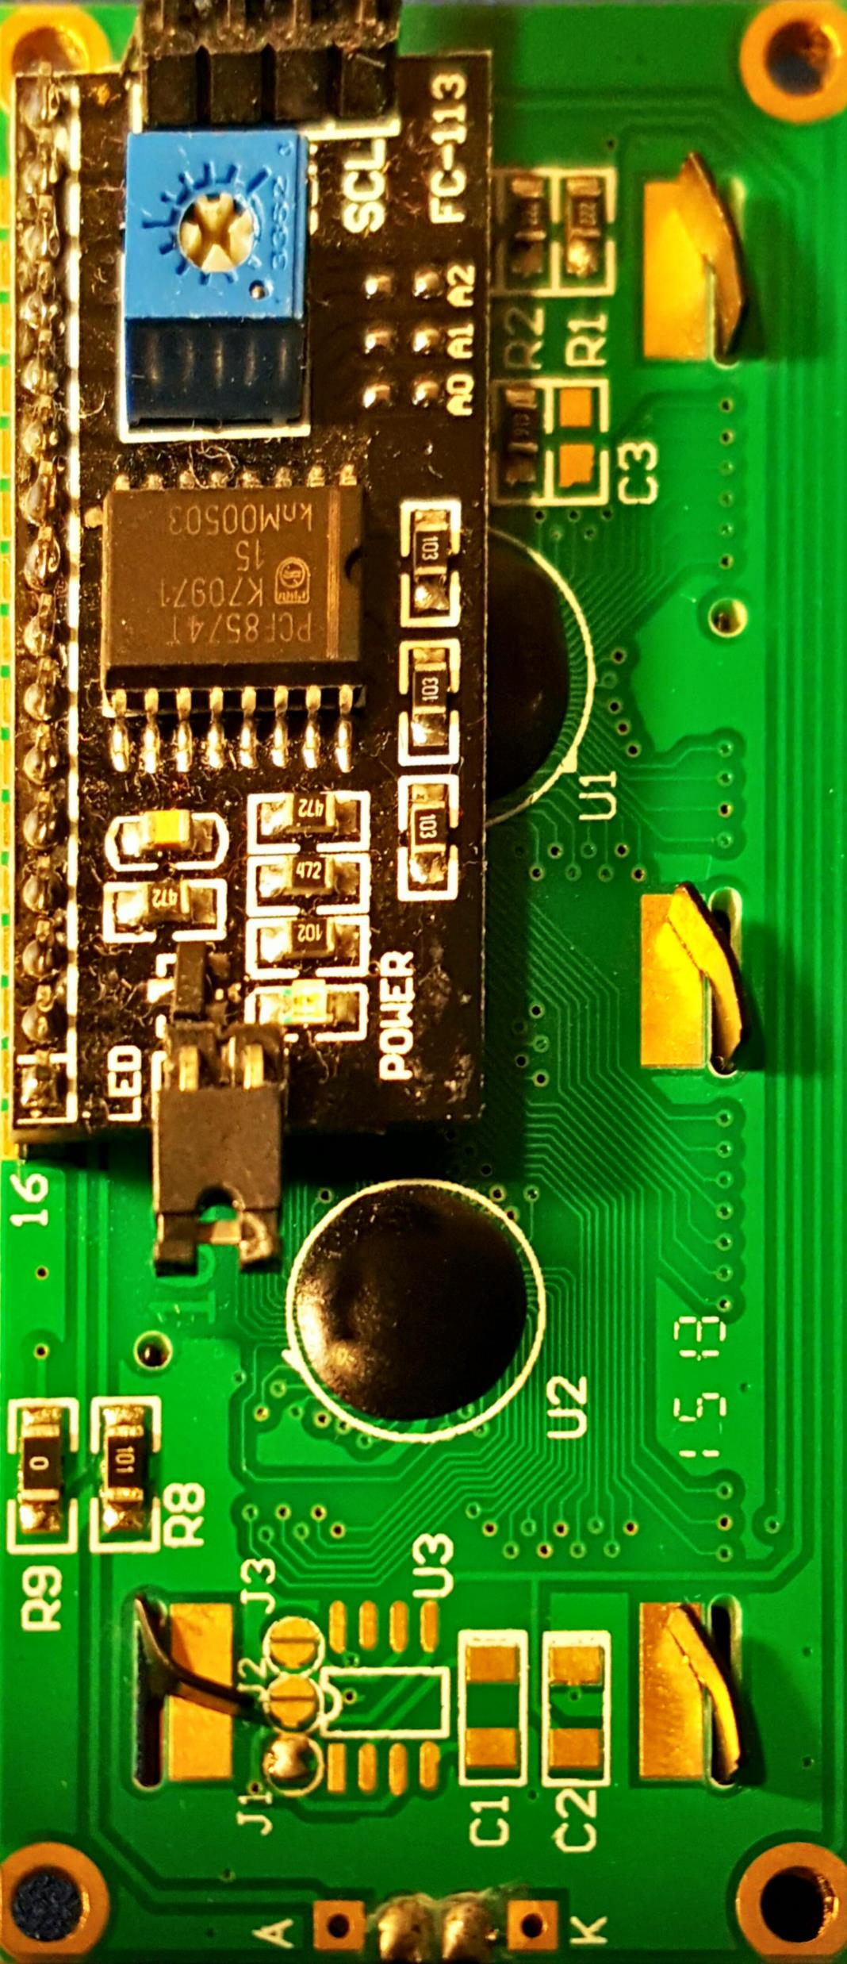
Uses of the ESP8266 (3)
Programming by Arduino IDE & NodeMCU
  Install CH340 driver
  Install the Arduino IDE 1.6.8+
  Add the ESP8266 repository (https://github.com/esp8266/Arduino)
  Tools --> Board menu -> Board Manager
  Library Manager
  Explore the Library Examples

Slide 12
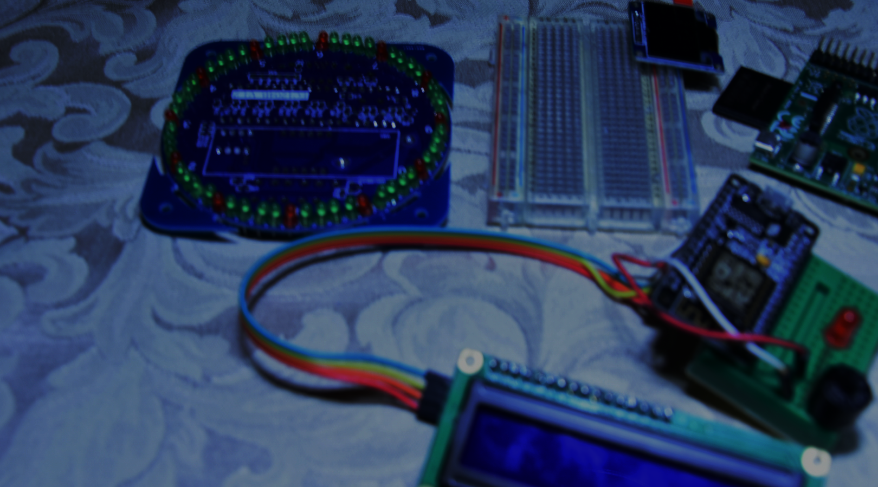

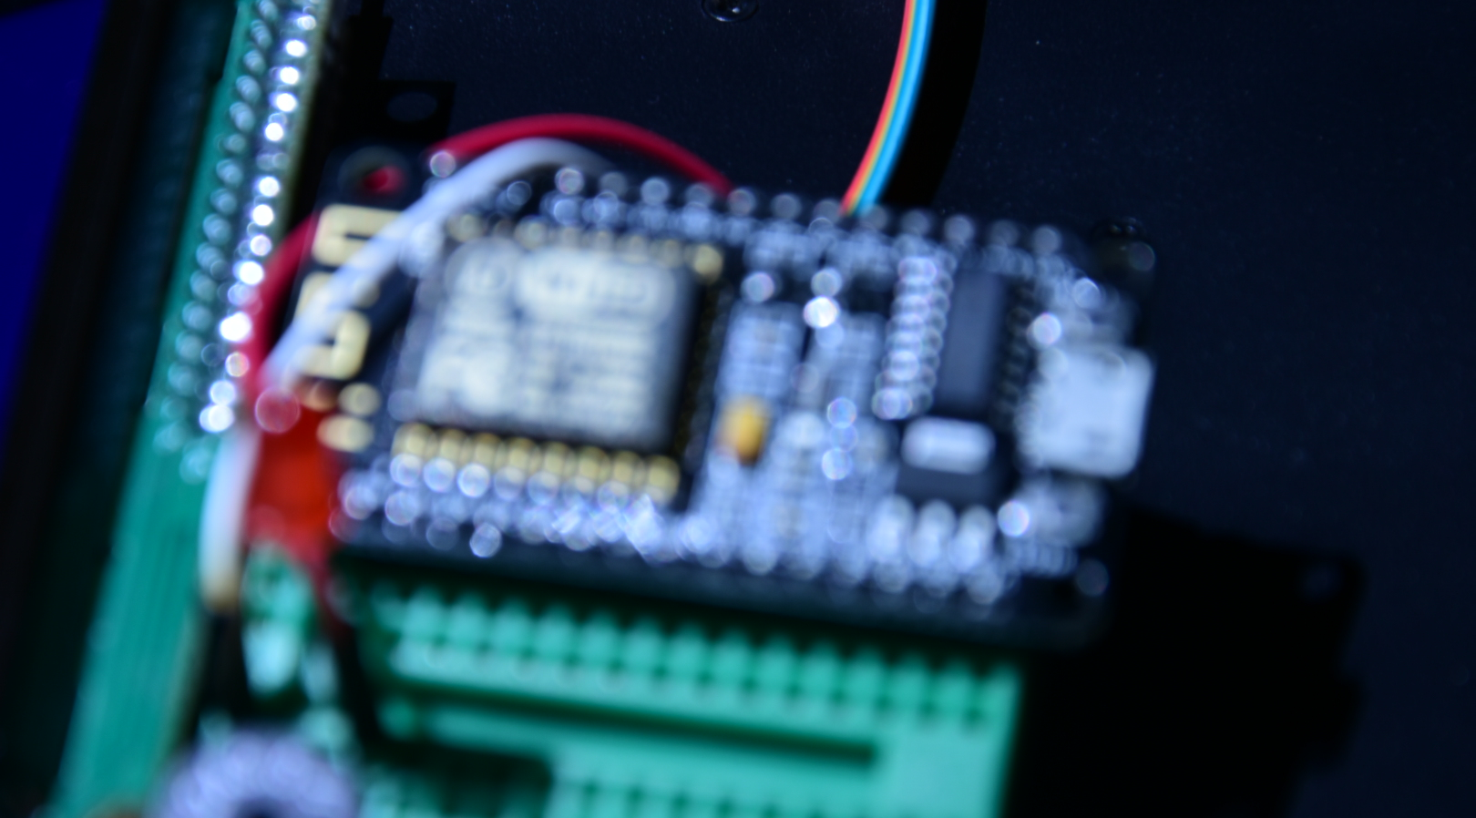
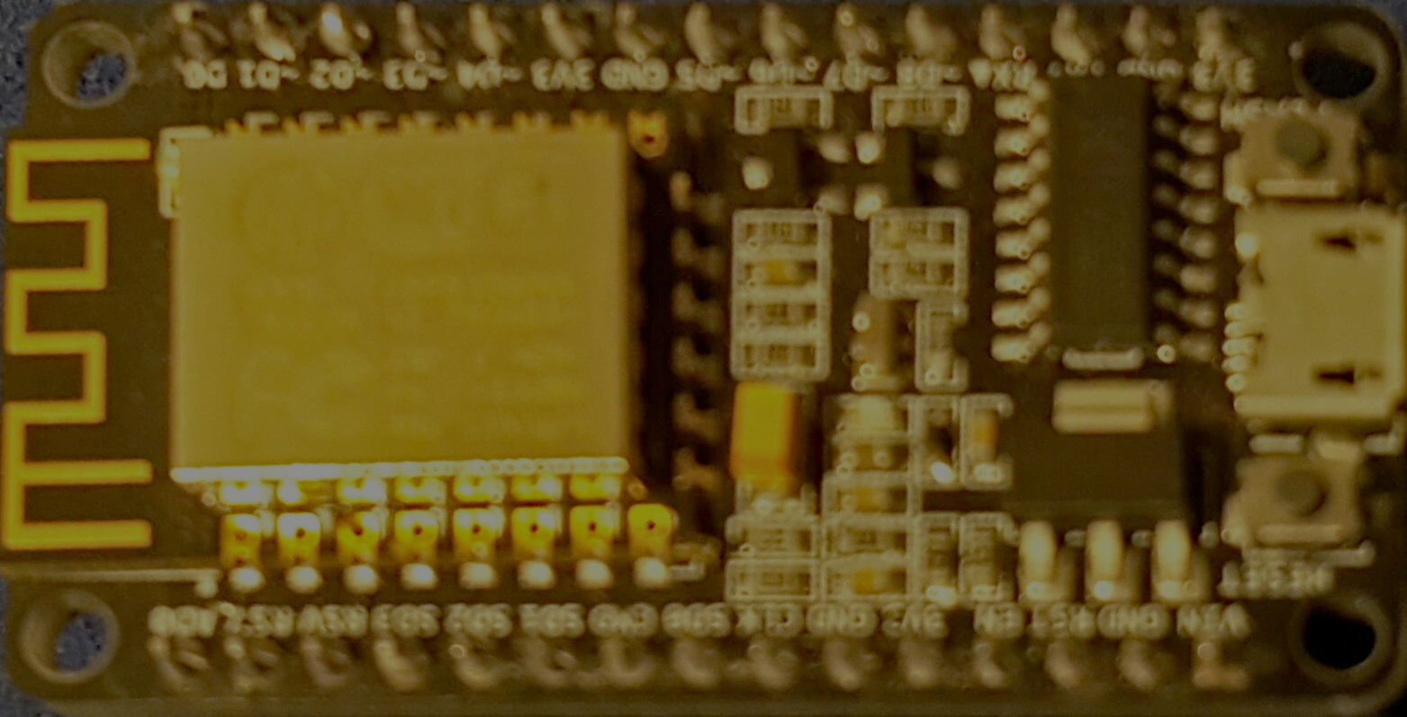
Best Setup for beginners (Your first shopping list)
NodeMCU (including the USB interface) 12E with 4MB+ RAM (critical later for OTA) .
Arduino IDE (use most the already existing Arduino Libraries).
Breadboard and some M-F, F-F, M-M jumper wires.
Some LED's and a buzzer .
A couple of Sensors Like DHT11 or the more accurate DHT22. (best when they are I2C or SPI interfaced)
An LCD 2004 or 1602 with I2C or SPI interface for saving PINs
If you insist on having the ESP-01 , remember that you will need an FTDI USB-Serial port module also.
Spoil yourself with NodeMCU motor shield if you want to build your own WiFi car later.

Slide 13

The <ESP8266WiFi.h> library
#include <ESP8266WiFi.h>
The following object is instantiated:
  WiFi (multiple Inheritance)
    .begin(ssid, password,…);
    .status()
    .localIP()
    config(localIP,gateway,subnet,dns1,dns2)
    isConnected()
    RSSI()
    beginWPSconfig();
    ..
Has the following Classes:
WiFiServer
server(80)
.begin();
WiFiClient client = server.available()
.available()
.flush()
.readStringUntil(‘\r’)
.println/print(String)
WiFiClient (connect to a web server)
.connect(server,80)
.print(String)
.stop()
.remoteIP() .remotePort()

Slide 14
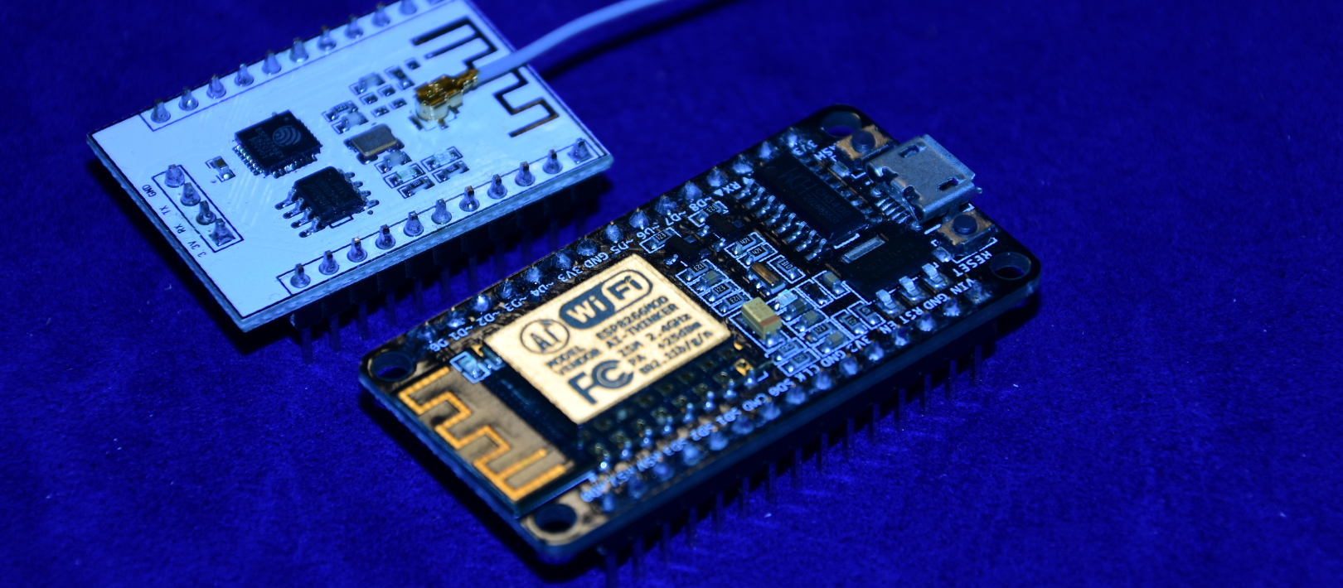
Connect as a WIFI Station
#include <ESP8266WiFi.h>
/*you could define “ssid” and “password” in .h file in your ArduinoIDE/libraires folder to avoid having to write them every time in your programs*/
WiFi.begin(ssid, password);
while (WiFi.status() != WL_CONNECTED) {
delay(500);
Serial.print(".");
}
Serial.println(WiFi.localIP());

Slide 15
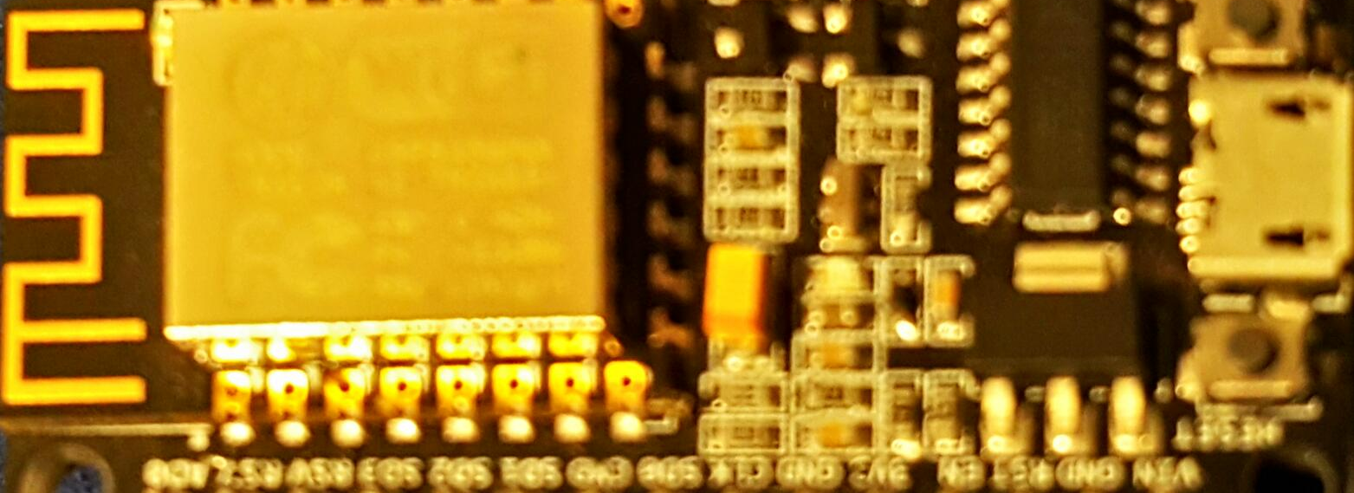
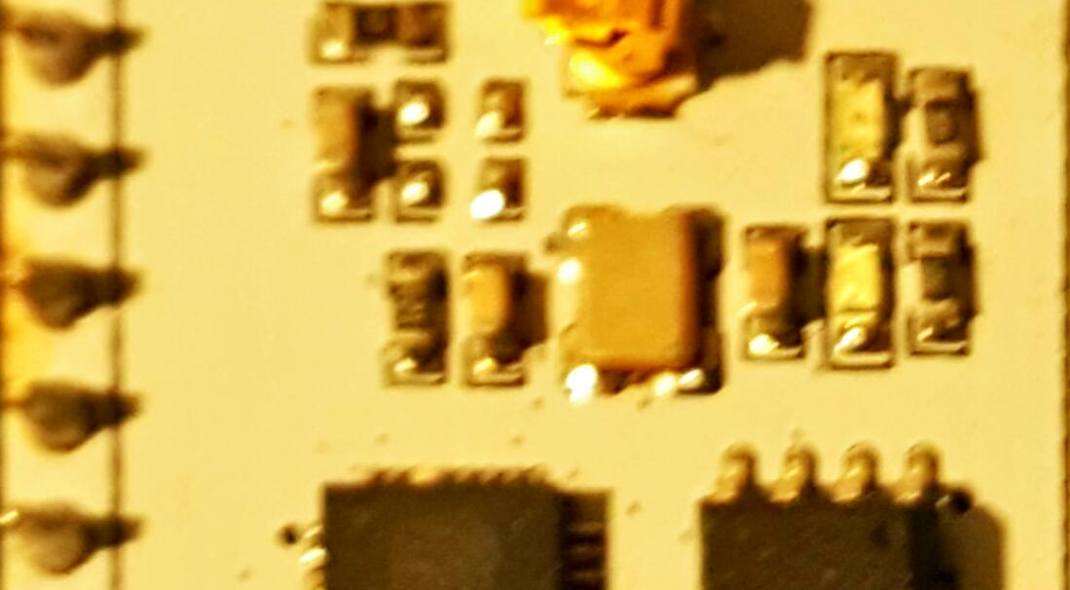
As an HTTP server
setup()
server.begin();
Loop()
// Check is some client connected
WiFiClient client = server.available();
if (!client) {
return;
}
// wait till client sends in some data
Serial.println("new client");
while(!client.available()){
delay(1);
}
// Read the GET/ POST request
String request = client.readStringUntil(‘\r’);
Serial.println(request);
client.flush();

Slide 16
Create an Access Point (AP)
#include <ESP8266WiFi.h>
void setup()
WiFi.mode(WIFI_AP);
WiFi.softAP(ap_name,psk_key);
server.begin();
void loop()
// Check if a client has connected
WiFiClient client = server.available();
if (!client) { return; }
// Read the first line of the request
String req = client.readStringUntil('\r');
Serial.println(req);
client.flush();
// process the “req” string
// Send the response to the client
client.print(response_str);

Slide 17
Connect to the web
/*
https://github.com/esp8266/Arduino/blob/master/libraries/ESP8266WiFi/examples/NTPClient/NTPClient.ino
sketch -> examples --> ESP8266/NTPClient/NTPClient.ino
*/
#include <ESP8266WiFi.h>
#include <WiFiUdp.h>
unsigned int localPort = 2390; // local port to listen for UDP packets
//IPAddress timeServer(129, 6, 15, 28); // time.nist.gov NTP server
IPAddress timeServerIP; // time.nist.gov NTP server address
const char* ntpServerName = "time.nist.gov";
// A UDP instance to let us send and receive packets over UDP
WiFiUDP udp;
setup()
wifi.begin and status checking loop
//Starting UDP
udp.begin(localPort);
void loop()
WiFi.hostByName("time.nist.gov", timeServerIP);
sendNTPpacket(timeServerIP); {
udp.beginPacket(address, 123); //NTP requests are to port 123
udp.write(packetBuffer, NTP_PACKET_SIZE);
udp.endPacket();
int cb = udp.parsePacket();
If (cb!=null)
udp.read(packetBuffer, NTP_PACKET_SIZE); // read the packet into the buffer
// calculations for epoc and UTC time

Slide 18
A typical ESP8266 project/product:
ESP_WebConfig Framework/ starting point. https://github.com/thunderace/ESP_WebConfig
Internet
JSON/XML
HTML
Connect as a station
REST
NTP
Router
/Switch
Join the ESP-AP and
configure the WIFI credentials
Starts as an AP
Config
Web
Pages

Slide 19
References and tools
Andreas Spiess Youtube channel
Internet of Things with ESP8266 by Marco Schwartz.
ESP8266 Weather station by Daniel Eichhorn.
NodeMCU dev kit using Arduino IDE by Magesh Jayakumar.
http://www.arduinesp.com/ is a good place to look for examples.
Office lens App@Android and Nikon DSLR to create the Background pictures.

